Slide 1

Producing Visualization using Income Census Dataset
SUBMITTED BY:
GARVIT MEHTA
100809489

Slide 2
Table of Contents
Visualization of the Dashboard
Data Description
Data Cleaning
Visualizations
YouTube Video Link
References

Slide 3
Questions we are trying to answer using the Income Census Dataset
Who is earning more… Male or Female ?
Why are they earning more?
Who is working for a greater number of hours ?
What are the top earning Occupation ?
Female Representation in these Occupations ?

Slide 4
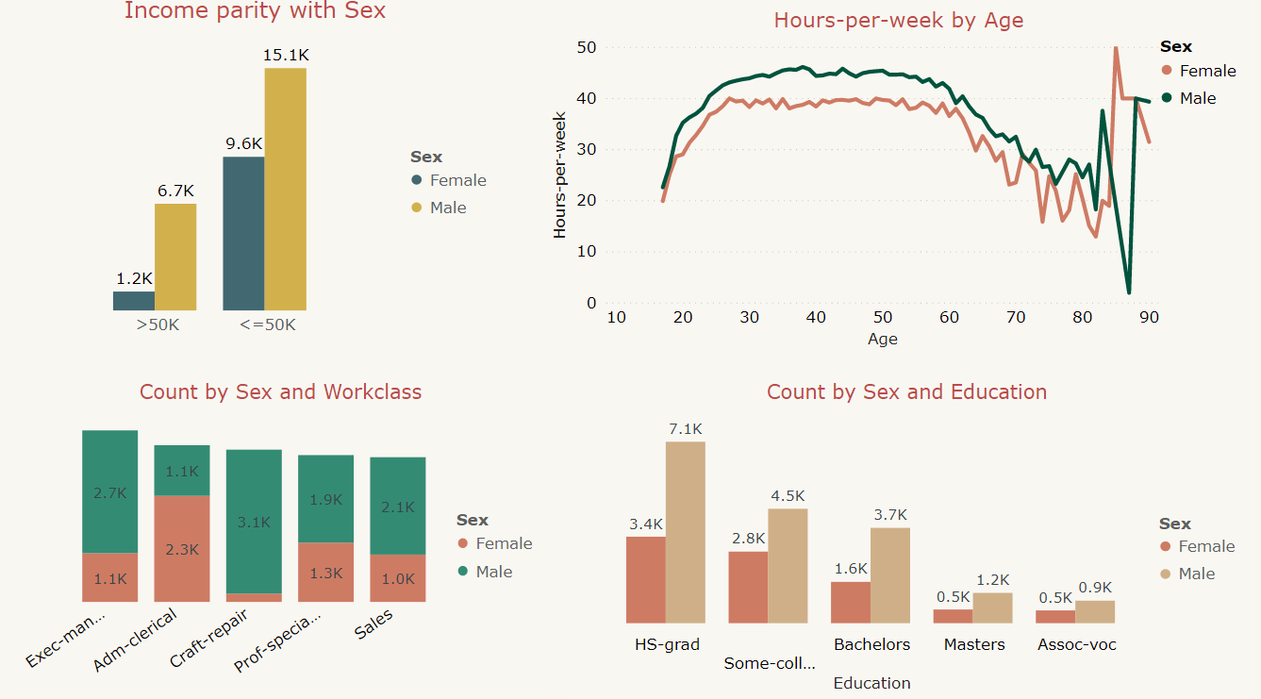
Visualization of the Dashboard

Slide 5

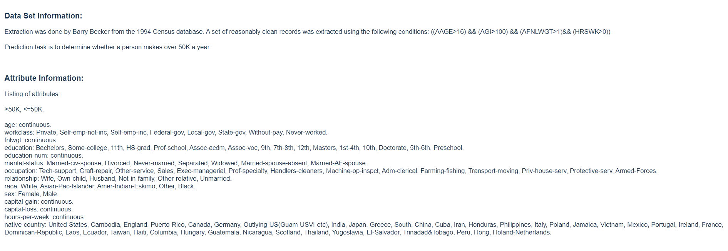
Data Description
The Census Income dataset consists of 16 columns and 16384 Rows

Slide 6
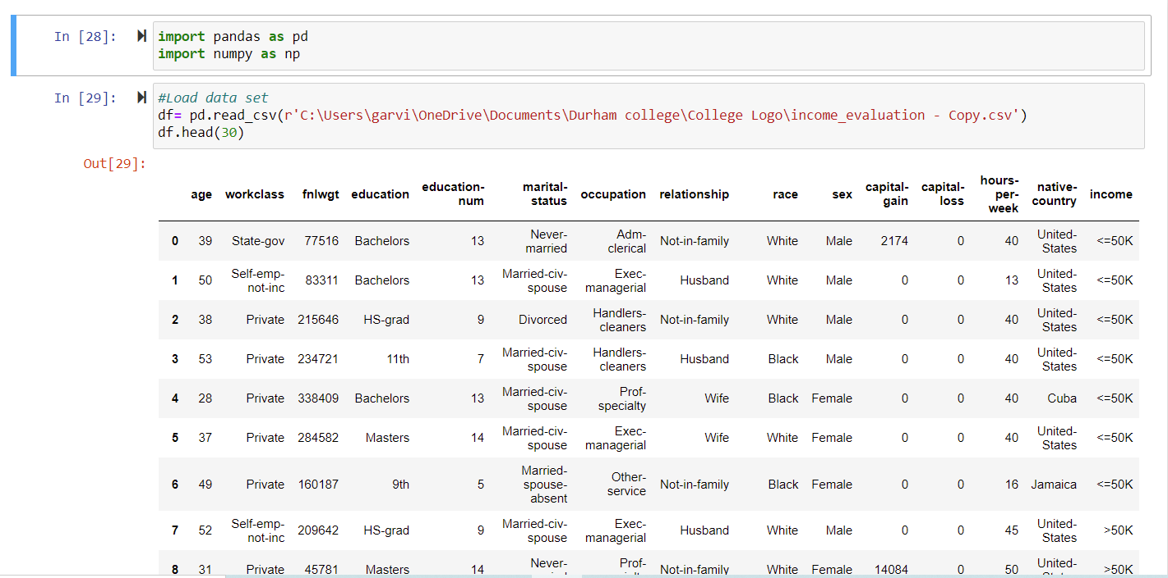
Data Cleaning Part 1…
Dropping the columns

Slide 7
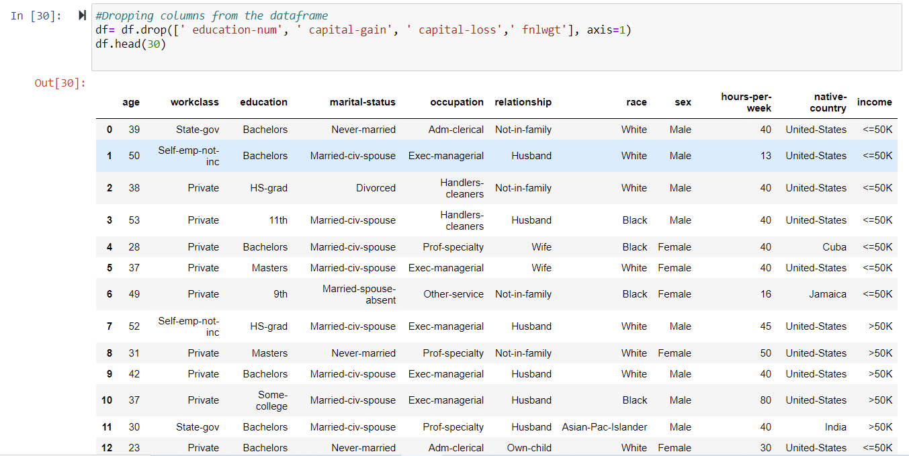
…Data Cleaning Part 1
Dropped the columns

Slide 8
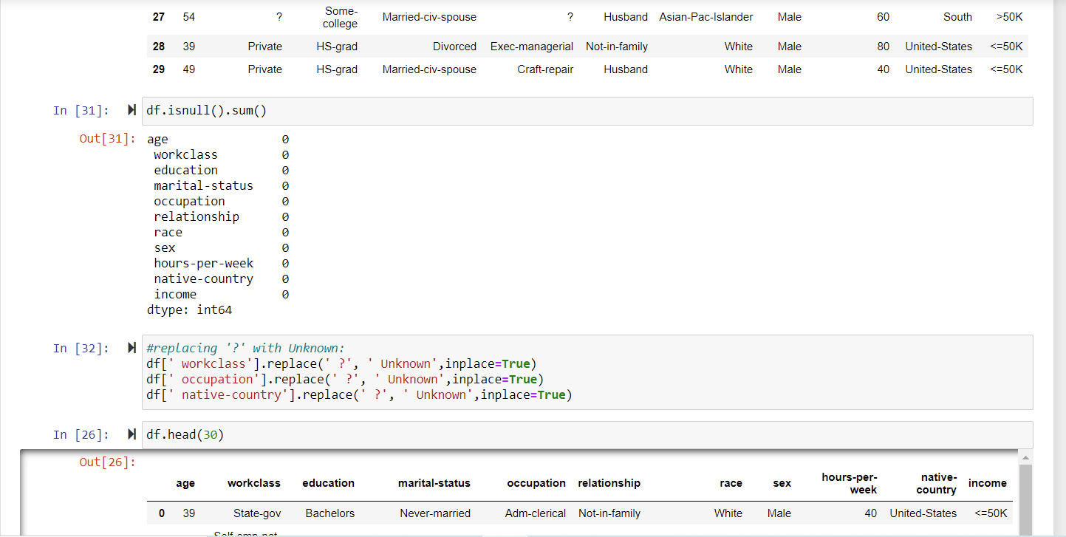
Data Cleaning Part 2
Checking for the Null values and replacing ‘?’ with ‘Unknown’

Slide 9
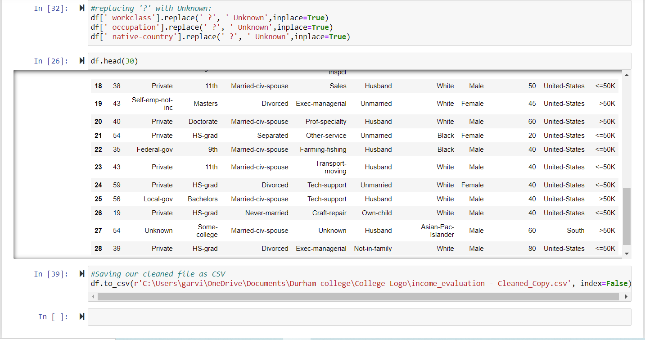
…Data Cleaning Part 2
Replaced the ‘?’ with ‘Unknown’

Slide 10
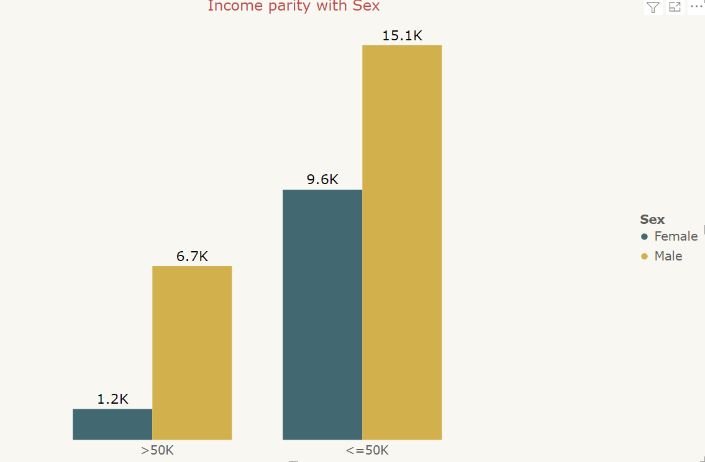
Who is earning more….?
Inferences from the chart
A clustered column chart is used for this visualization. The Income category is at X axis and the count of the Males and Females on Y axis.
It can be inferred from the chart that number of Males earning more than $50k is almost five times the number of Females.
Men are more likely to earn more than $50K

Slide 11
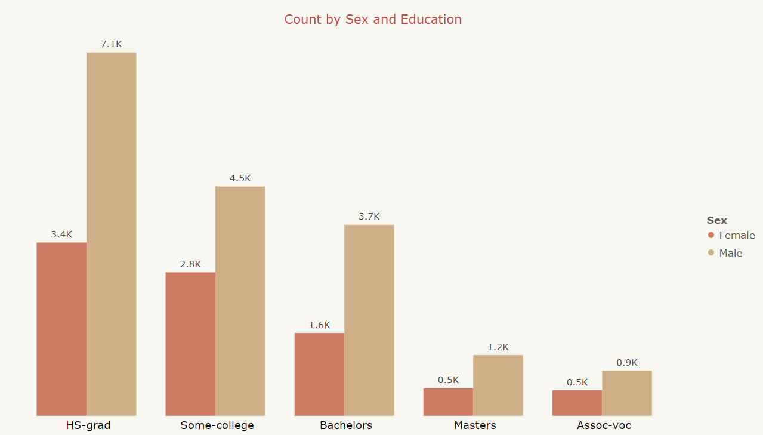
Why are they earning more…. ?
Inferences from the chart
A Stacked Column Chart has been used to show the count of people (Y axis) based on the level of Education (X axis) attained by them.
The visual shows that more Men are likely to attain a certain level of education as compared to their female counterpart.
No surprises here as to why Men are earning more than females. Since men are more educated than females they are better paid off for their job and are earning handsomely.

Slide 12
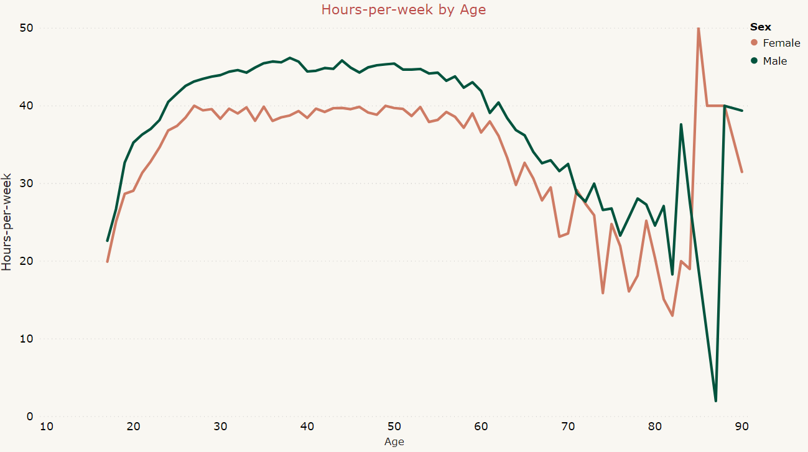
Who is working for a greater number of hours….?
Inferences from the chart
A line chart has been used to establish the relation between Hours per week (Y axis) spent by an individual (Sex as legend) and their Age (X axis).
We can see that Males put in more no. of hours than Females for almost all Ages. This trend continues till age 85, after which females have worked more. In the age range from 85-88, females have outperformed the males, thereafter which males again worked for more no of hours. Overall, we can say Males have put more number of hours working than Females.

Slide 13
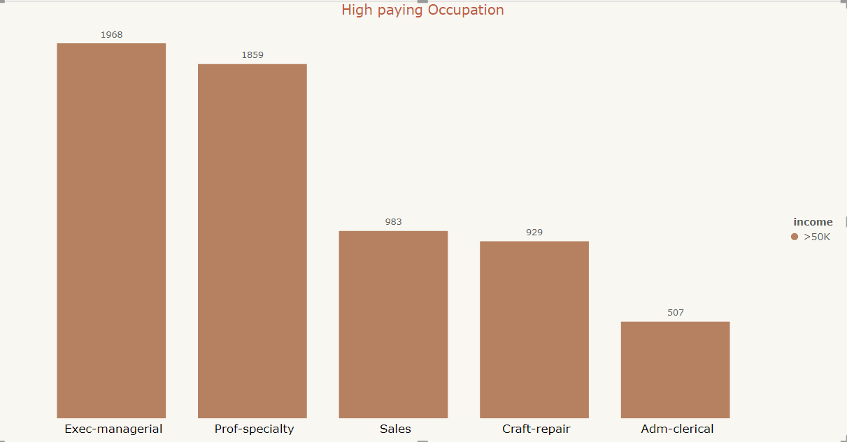
What are the high paying Occupations….?
Inferences from the chart
A Clustered Column Chart is used for this visualization. Type of Occupation is in (X axis) and Count of people under that occupation is in (Y axis).
This chart presents the number of people employed in occupations which are paying more than $50k.
It can be seen from the chart that Exec-managerial is the highest paying occupation with 1968 professionals working in it, followed by Prof-specialty with 1859 and last is Adm-clerical with 507 professionals employed in the same occupation.

Slide 14
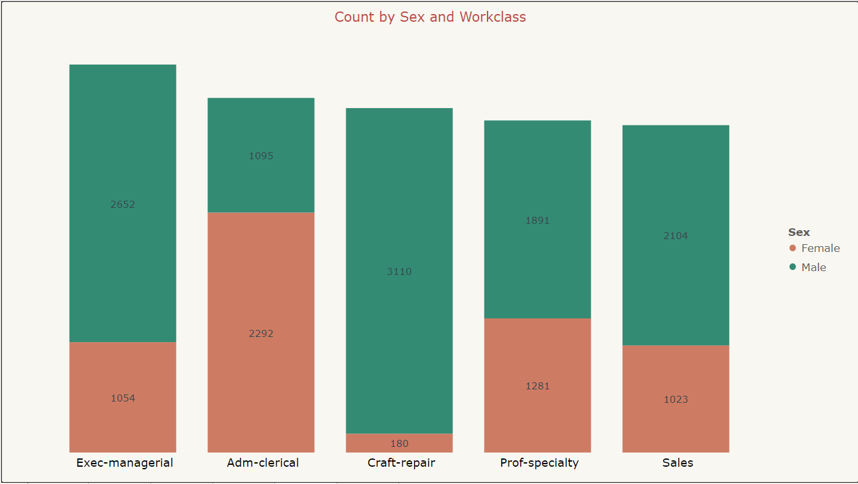
Female representation in these Occupations….?
Inferences from the chart
A Stacked column chart is used for this visualization. The Occupation is in X axis and Count of people is in Y axis. It is further filtered by the gender of these people.
The chart represents the Highest paying occupation with Female representation. The number of females in any occupation (highest paying occupation) are less compared to their male counter parts except the Adm-clerical job where females have out played males.
Since less females take up the highest paying occupation, we can easily understand why they are getting paid less compared to males.

Slide 15
Conclusions
According to the Income Census data it can be concluded that Males earn more than Females, this can be attributed to the following facts:
Males are more educated as compared to their counter parts for any level of education.
They can devote more hours at work as compared to women.
Males have more opportunities to work in highest paying Professions, whereas, Females have less representation in these Occupations.

Slide 16
Video Link
Please find the link below to my YouTube channel for the Interactive Video presentation:
https://youtu.be/V9tgT2PcVfY

Slide 17
References
The Census Income dataset has been taken from: UCI machine learning repository.
Data Link: https://archive.ics.uci.edu/ml/datasets/census+income

Slide 18
Thank You

